Slide 1
Bird-Window Collisions: A Summary in Seven Slides
Photo: Wood Thrush by Paul Rossi

Slide 2
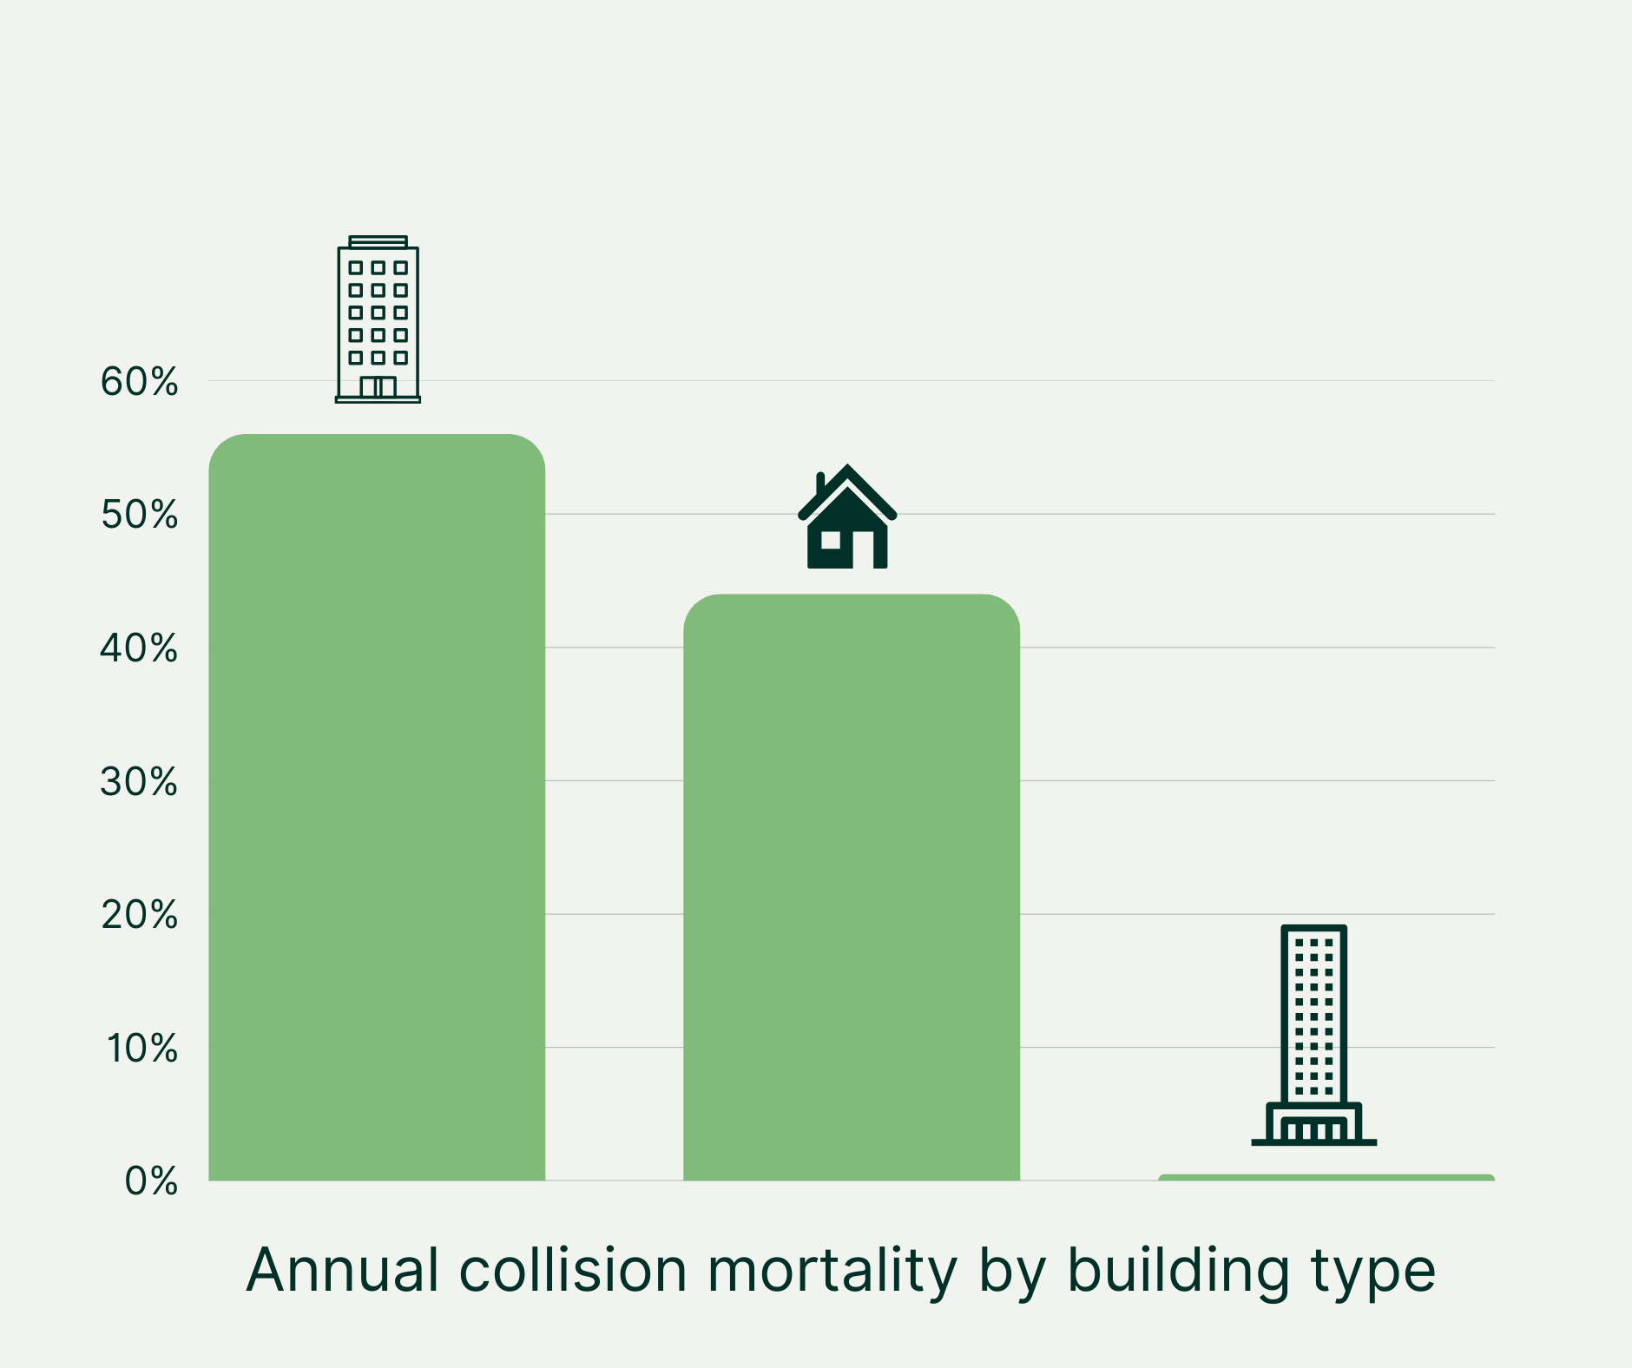
Bird-window collisions
Kill over 1 billion birds in the US each year (Loss et al. 2014)
Incorrect tendency to associate collisions and skyscrapers
<1% at high rises over 12 stories
Majority (56%) occur at mid rise buildings
44% at low rise businesses and homes
Occur mainly at lower levels where birds are most active
Notes:
How common are collisions? The Smithsonian did a meta-analysis and calculated that up to a billion birds a year are dying from collisions with glass every year in the US alone. Recent studies have shown that to be an underestimate, because collision monitors do not find the majority of birds that strike windows, and many that initially survive collisions later succumb to their injuries.
Yet people think it is uncommon because we don’t see millions of dead birds on the ground. Even at a building that kills many birds, we don’t typically see so many lying because of scavengers and cleaning staff.
There is a tendency to associate collisions and skyscrapers, but this is not an accurate depiction of reality. Less than 1%
Majority, 56% occur at mid-rise
Remainder 44% homes 1-3 stories
Some high rise buildings can be bird killers, and because there are relatively few of them compared to mid and low rises, they only make up a tiny portion of the total, but even at high rise buildings most collision occur at the lower levels. This is where birds are the most active when feeding and flying.

Slide 3
Bird-window collisions
Majority of collisions are song birds
Peak collisions during fall migration, followed by spring migration
Winter collisions occur often at homes, especially those with feeders; late spring as local birds fledge young
Many birds fly away, but may not survive their injuries
Notes:
Almost every kind of bird out there has hit glass at one time or another, but most of them are native songbirds– thrushes, warblers, sparrows, hummingbirds. Birds that migrate long distances between their winter grounds in the south and their breeding grounds in the north.
When they migrate we see large peaks in collision rates.
They migrate at night and come down to stop over during the day (imagine if you were on a cross-country road trip, you need to stop to eat a refuel). And when they make these stops they’re often in close proximity to dangerous glass– this is when the majority of collisions happen.
However, since many collision monitoring programs happen in spring and fall in cities, this is an incomplete picture. Many collisions happen in winter, especially at homes. Feeders attract birds near dangerous glass.
A recent study found that 60% of collision victims that are taken to rehabilitation centers do not survive their injuries

Slide 4
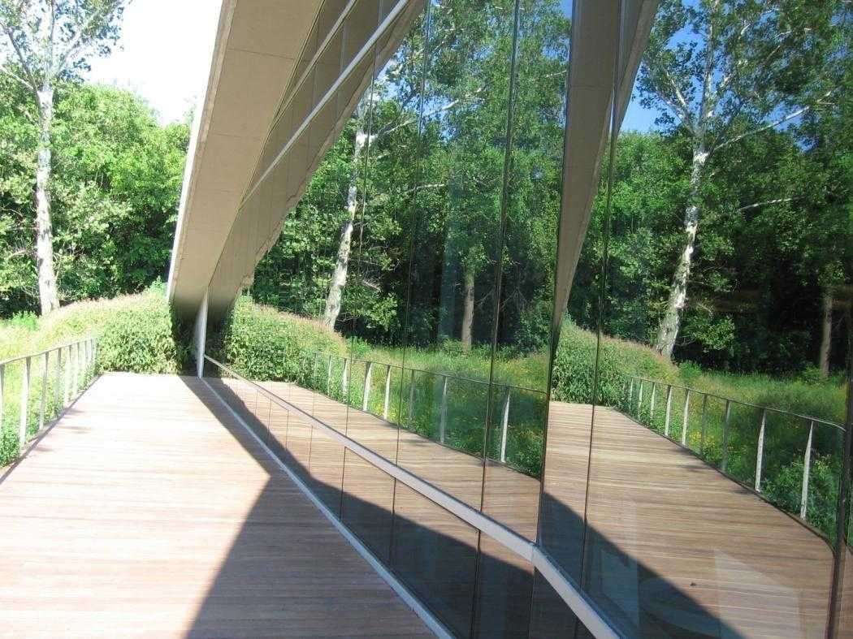
Why do birds hit glass?
Humans use architectural cues to know where not to expect glass
Mullions, facades, door handles etc.
Birds don’t recognize those cues
Birds take things literally!
Reflection in glass = habitat
Vegetation behind glass = habitat
Sky through a skywalk = habitat
To learn more about why collision happen and myths about collisions visit: abcbirds.org/blog/truth-about-birds-and-glass-collisions
Notes:
People often think they can see glass. In reality we cannot see the glass- it is transparent, we learn where to expect glass often when we’re very small. Often after running into it a couple times.
We understand where to expect glass based on visual cues, and when those are removed even adults will run into glass. But you can put a few small decals on that glass and people will realize they’re aren’t floating in space, there must be glass present.
Birds cannot learn the concept of glass. Birds see reflections as reality. They take it literally. A reflection like this to a bird is a destination to fly to.
To learn more about why collision happen and myths about collisions visit our expert FAQ at abcbirds.org/blog/truth-about-birds-and-glass-collisions

Slide 5
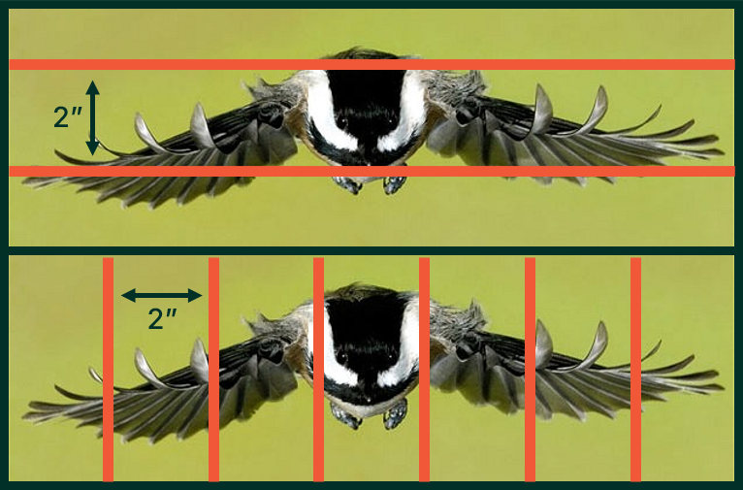
How to make glass bird friendly?
Put markers on glass that birds avoid
Markers must be visible
On the outside of the glass
Have enough contrast for birds to see.
Be large enough for birds to see in time to stop
Markers must be spaced appropriately
Markers must be close enough together that birds don’t think they can fit through
2” by 2” spacing is best
Notes:
To stop collisions we use visual markers that birds see as solid, and space them appropriately so that birds don’t think they can fit between them.
Marker rules: Must be visible!
They must go on the outside of the window or they will be obscured by reflections in the glass
The must have enough contrast so birds can see them and large enough for birds to see them in time to stop
Birds have lower contrast sensitivity than we do, so they can’t distinguish shades of grey very well. They also have bad depth perception.
Must be big enough. The markers themselves have to be visible– so lines should be 1/8” in width and dots ¼” diameter to ensure birds can see it.
MOST IMPORTANT Birds have very accurate knowledge of how big their bodies are and how wide their wingspans are, and many species can maneuver through tight spaces.
We base the size guidelines on the body dimensions of the smallest birds. That means markers should be spaced about 2” apart.
Previously the 2x4 rule was the recommended spacing but in practice small birds were still colliding. If we make glass safe for the hummingbirds and kinglets, it will be safe for all the larger birds too.

Slide 6
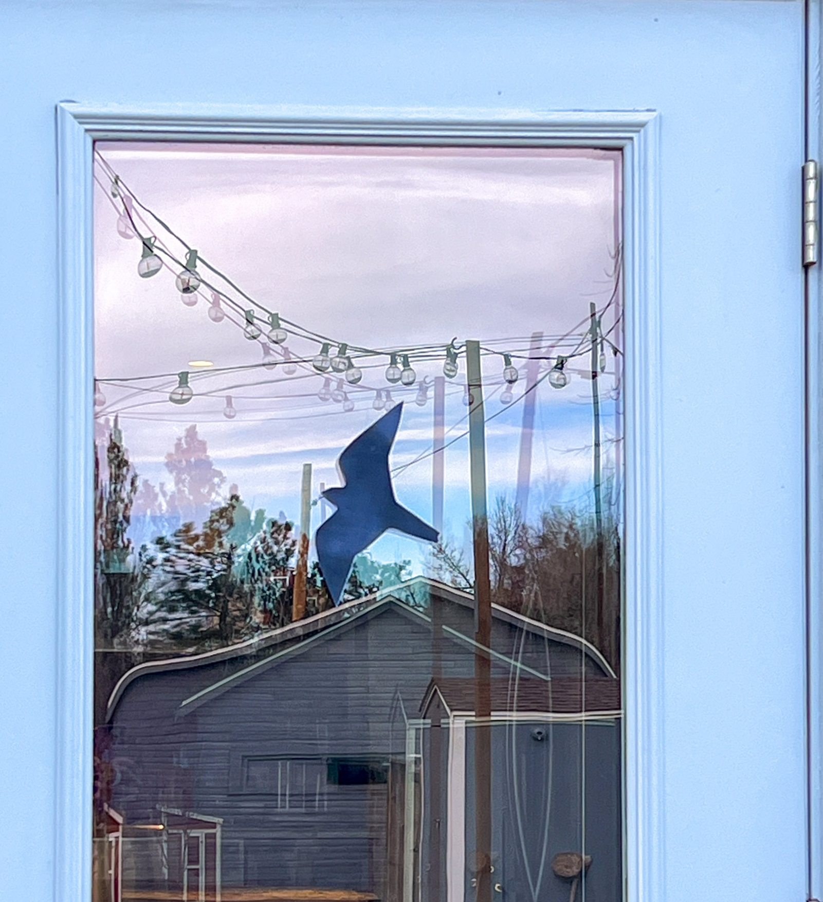
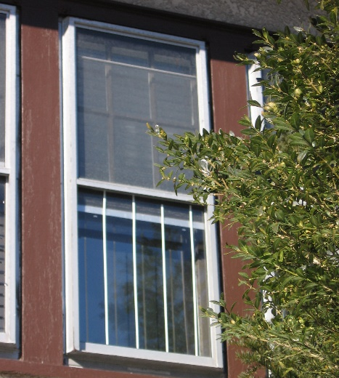
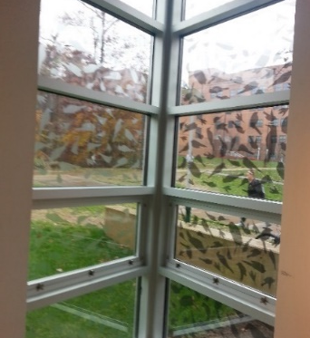
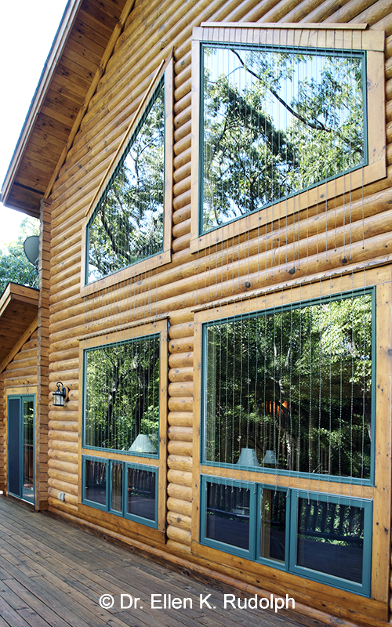
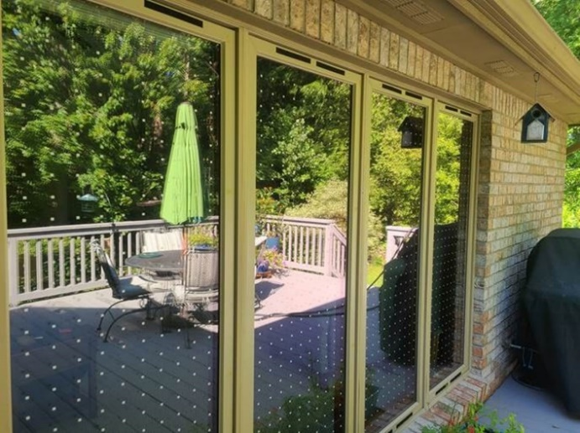
Bird friendly glass at home
To see more bird-friendly options for your home visit
https://abcbirds.org/solutions/prevent-home-collisions/
Notes:
Single decals don’t work! Options inclue parachute cords, decals, films, and tape. Insect screens are great!

Slide 7
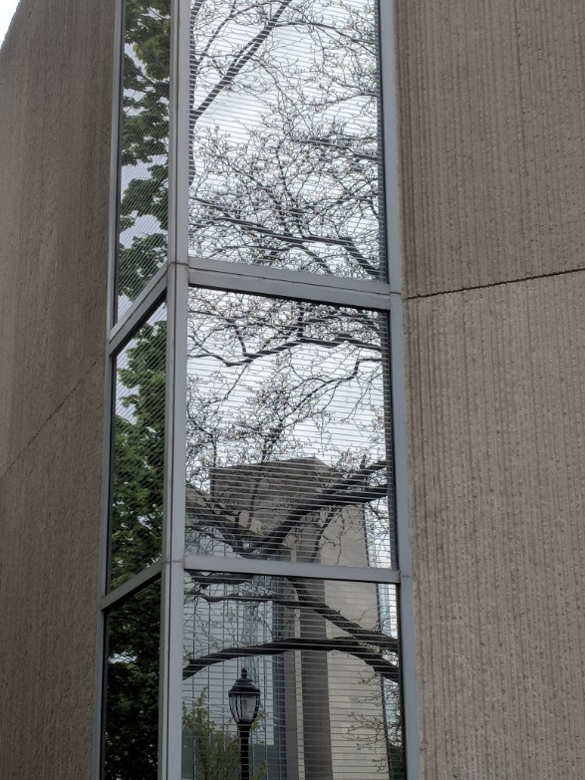
How you can help
Advocate for buildings that kill birds to put solutions in place and work with building owners and managers to find solutions
See https://abcbirds.org/glass-collisions/advocate-retrofits/ for tips
Advocate during the planning stage for new buildings to be bird friendly
See https://abcbirds.org/glass-collisions/architecture-planning/ for resources
ABC is here to help!
A bird-friendly retrofit (Solyx film) at Northwestern University
Notes:
While we’d love to fix every single window, being pragmatic and recognizing the cost and effort that goes into installing retrofits, Here are the basic steps to getting a retrofit in place.
1. Pay attention. Document collisions, in order to choose the priority windows to fix.
2. Choose a solution
3. Put it up
4. Go back to step 2 and ensure your solution is working an identify more windows that need fixing
Working building by building on new construction can be incredibly time consuming. But it can be helpful from the perspective of press and PR, lots of fanfare and getting the word out. ABC staff can help work with design professionals and support your efforts

Slide 8
Bird-friendly Policy
The best way to address collisions on a large scale is to pass bird friendly policies!
Organizations (e.g. colleges)
Agencies (e.g. Parks departments)
Municipalities (counties, cities, states)
28 municipalities have passed mandatory bird-friendly ordinances so far.
See https://abcbirds.org/glass-collisions/legislation/ for a model ordinance and more resources
Alameda, CA
Berkeley, CA
Cook County, IL
Cupertino, CA
Emeryville, CA
Evanston, IL
Highland Park, IL
Howard County, MD
Illinois (State)
Lake County, IL
Madison, WI
Maine (State)
Maryland (State)
Middleton, WI
Minneapolis, MN
Minnesota (State)
Mountain View, CA
New York, NY
Oakland, CA
Palo Alto, CA
Portland, ME
Portland, OR
Richmond, CA
San Francisco, CA
San Jose, CA
Santa Cruz, CA
Washington, DC
Wisconsin (State)
Notes:
The best way to address collisions on a large scale is to pass bird friendly policies! They can be organizations, at an agency, or at the municipal level.
Here is a list of current mandatory municipal ordinances in the US.
We have the a model ordinance with right language, it pretty strong. If it was passed it would be the strictest ordinance in place, but it’s a good starting point and we also have guidance for walking it back and creating one that works for your community.
We also have a review of existing legislation including which we recommend and which we don’t and why. We do advise starting with a model ordinance instead of just copying an existing one because they all have pros and cons and were a result of compromises.

